Slide 1

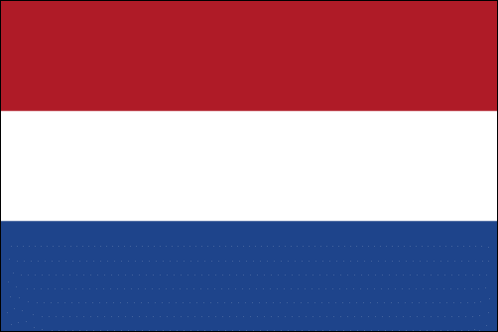

Life science trend analysis
Netherlands ｜2026
March 2026

Slide 2



About us
The following statistical information has been obtained from Biotechgate, a global, comprehensive life science database encompassing the biotechnology, pharmaceutical and medical device industries.
www.biotechgate.com
The Dutch Life Sciences Database is a part of the global Biotechgate and is brought to you in partnership with Hollandbio.
www.dutchlifescience.com
Biotechgate is owned and operated by Venture Valuation AG, a Zurich based company specializing in independent assessment and valuation of technology-driven companies in high growth industries, such as the life sciences (biotech, pharma, medtech), ICT, high-tech, nanotech, cleantech and renewable energy.
www.venturevaluation.com

Slide 3
Our partner
Hollandbio connects, supports, and represents over 270 medical, agro-food, and industrial biotech companies. Their members are active in all phases of research and development and include all company sizes: start-ups, SMEs, listed companies and multinationals.
Together, they strive for a society taking full advantage of the power of biotechnology in health, food and sustainability.
Explore the hollandbio life Science Database run by Biotechgate, which shows the Netherland’s vibrant, dense biotechnology cluster of nearly 2000 life sciences companies and research organizations, all within a 120-mile radius.

Slide 4
Overview of the life science industry
NUMBER OF COMPANIES By Sector
Biotech
companies
537
Digital Health
Companies
Fully integrated pharma
companies
79
47
1988
medtech
companies
investor
companies
173
other
Life science
related companies*
111
1041
For the definition of categories please visit www.biotechgate.com/web/cms/index.php/covered_industry_sectors.html. Biotech Companies include the following categories: Biotechnology – Therapeutics and Diagnostics; Biotechnology – R&D; Biotechnology – Other. *Other life science related companies include supplier & engineering, professional services & consulting, media and public / non-profit organizations / medical facilities. Professional services & consulting includes 6 companies of the category “Media”. Percentage value is expressed as % of total number of companies. Information displayed may alter as new information is received continuously

Slide 5
Overview of BIOTECH COMPANIES
NUMBER OF COMPANIES By Sector
• biotech •
therapeutics
• biotech •
R&d services
178
222
Biotech
companies
537
• biotech •
other
137
For the definition of categories please visit www.biotechgate.com/web/cms/index.php/covered_industry_sectors.html. Biotech Therapeutics category equals to Biotech Therapeutics and Diagnostics. Percentage value is expressed as % of total number of biotechnology companies including Biotech - Therapeutics and Diagnostics, Biotech - R&D Services and Biotech – Others. Information displayed may alter as new information is received continuously.

Slide 6
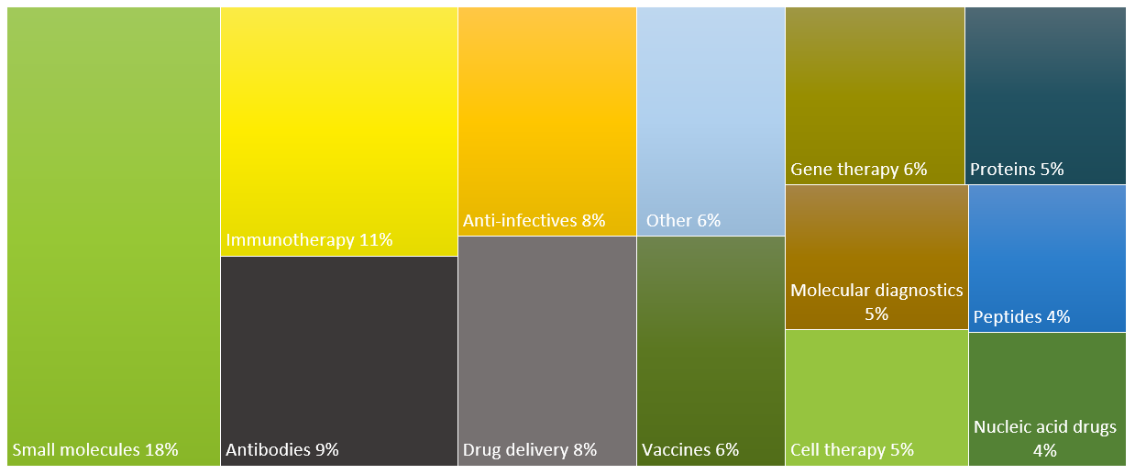
Biotech – Therapeutics & Diagnostics companies by key activities
As percentage of total number of BIOTECH - therapeutics COMPANIES
For 178 Biotech Therapeutics companies there were 304 subsectors (key activity areas) assigned (one biotech company can be active in multiple areas). The graph displays Biotech – Therapeutics and Diagnostics subsectors as the percentage of the total number of Biotech – Therapeutics and Diagnostics subsectors with exclusion of the category “Others” or categories with a share of 2% or less. The company subsectors are regarded as the key activities of a company. For the definition of subsectors please visit www.biotechgate.com/web/cms/index.php/covered_industry_sectors.html. Information displayed may alter as new information is received continuously.

Slide 7

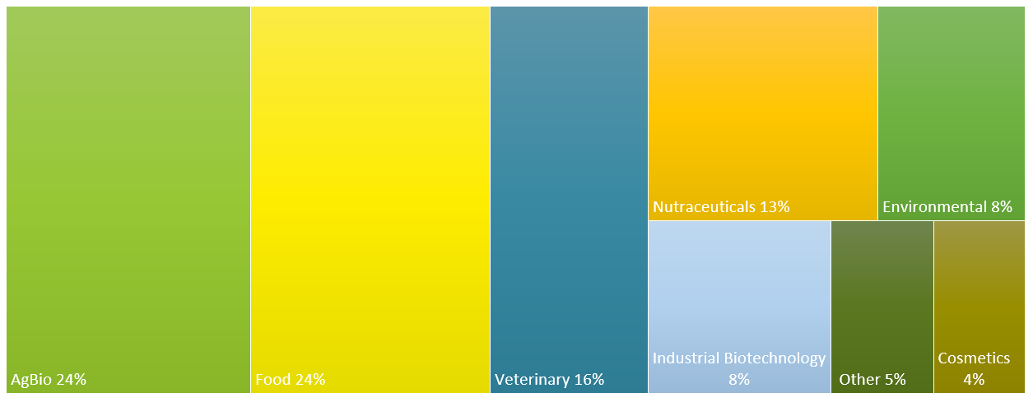
Biotech - other companies by key activities
As percentage of total number of BIOTECH - other COMPANIES
For 137 Biotech - Other companies there were 200 subsectors (key activity areas) assigned (one biotech company can be active in multiple areas). The graph displays Biotech – Other subsectors as the percentage of the total number of Biotech – Other subsectors with exclusion of the category Others. The company subsectors are regarded as the key activities of a company. For the definition of subsectors please visit www.biotechgate.com/web/cms/index.php/covered_industry_sectors.html. Information displayed may alter as new information is received continuously.

Slide 8
BIOTECH ASSETS IN CLINICAL DEVELOPMENT
BY INDICATION AND DEVELOPMENT PHASE
BREAKDOWN BY INDICATION
BREAKDOWN BY DEVELOPMENT PHASE
Both graphs contain the number of assets of Biotech – Therapeutics and Diagnostics companies (excl. Pharma or Biotech – Others or Biotech R&D Services companies). In this analysis, development stages are shown separately, including Discovery, Lead Optimization, Preclinical, Phase I, Phase I/II, Phase II, Phase II/III, and Phase III. Information displayed in the chart may alter as new information is received continuously.

Slide 9
Assets available for out-licensing
NUMBER OF ASSETS
BY ASSET CLASS
THERAPEUTICS in development
by DEVELOPMENT PHASE
The graph titled “Therapeutics in Development by Development Phase” displays a subset of the asset class Therapeutics. Products in Discovery and Lead Optimization Phase are merged into Preclinical; Development Phase I/II trials are merged into Phase II and Phase II/III trials are merged into Phase III category.

Slide 10
OVERVIEW OF Ownership
PERCENTAGE OF TOTAL NUMBER OF COMPANIES BY OWNERSHIP AND SECTOR
For the definition of categories please visit www.biotechgate.com/web/cms/index.php/covered_industry_sectors.html. Biotech T & D stands for Biotech Therapeutics and Diagnostics. Percentage value is expressed as % of total number of companies in the sector. Information displayed may alter as new information is received continuously.

Slide 11
COMPANY Foundation timeline
NUMBER OF LIFE SCIENCE COMPANIES FOUNDED BY YEAR | 2015-2024
The graph contains the number of privately owned or publicly listed (no subsidiaries) life science companies founded by year including Biotech - Therapeutic and Diagnostic, Biotech - R&D Services, Biotech – Others, Pharma, Medical Technology and Digital Health companies. Companies founded in 2025 were excluded since newly founded companies often remain under the radar until their first financing round. The information displayed in the chart may alter as new information is received continuously.

Slide 12
Venture financing OF LIFE SCIENCE companies
Private Equity Rounds | 2024-2025
Life science companies
Biotech companies
Life Science companies include Biotech - Therapeutics and Diagnostics, Biotech - R&D Services, Biotech – Others, Pharma, Medical Technology and Digital Health companies. Biotech companies are a subset of Life Science companies and include: Biotech - Therapeutics and Diagnostics, Biotech - R&D Services, Biotech – Others. Financing data only includes private equity rounds (excl. private placements in public companies). Data may alter as new information is continuously received and/or new tranches to existing financing rounds are added.

Slide 13
Biotech VENTURE financing
PRIVATE EQUITY ROUNDS – 5 YEAR REPORT
Biotech companies are a subset of Life Science companies and include: Biotech - Therapeutic and Diagnostic, Biotech - R&D Services, Biotech – Others. Financing data only includes private equity rounds (excl. private placements in public companies) of biotech companies (incl. therapeutic and diagnostic, R&D services and others). Data may alter as new information is continuously received and/or new tranches to existing financing rounds are added.

Slide 14
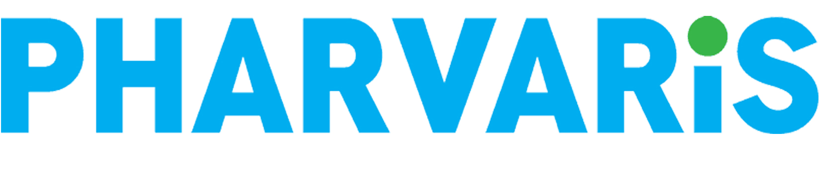





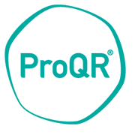



BIOTECH IPOs
Dutch BIOTECH COMPANIES THAT WENT PUBLIC Worldwide | 2013-2025
2021-2025
$165M
$328M
$100.5M
2017-2020
$116.7M
2013-2016
$89.70M
$81.90M
$54.21M
$131.68M
$47.30M
$36.30M
+$200M
$100-200M
$0-100M
Included are Biotech – Therapeutics and Diagnostics, Biotech – R&D Services, and Other Biotech companies.

Slide 15





Major biotech venture financing rounds (2025)
TOP 5 Dutch PRIVATE EQUITY FINANCING ROUNDS | 2025
Company | Sector | Type of Round | USD M
Azafaros B.V. | Biotech – Therapeutics | Series B | $149.36
Leyden Laboratories B.V. | Biotech – Therapeutics | Other / unknown | $70.00
Alesta Therapeutics | Biotech – Therapeutics | Series A | $67.15
Avidicure | Biotech – Therapeutics | Seed | $50.00
The Protein Brewery | Biotechnology - Other | Series B | $35.20
The table shows the five biggest private equity financing rounds (excl. IPOs, research grants, loans) of private and independent biotech companies in the Netherlands in 2025. Information displayed in the table may alter as new information is continuously received and/or new tranches to existing financing rounds are added.

Slide 16



Major biotech And Pharma M&A Deals (2025)
m&A deals | 2025
Acquired entity | Buyer | Phase of lead asset (of acquired entity) | USD M
Merus N.V. | Genmab A/S | On the market | $6900
Lava Therapeutics N.V. | Xoma Royalty Corp | Phase I/II | $32.6
The table shows the M&A deals of private and independent life sciences companies in 2025. Information displayed in the table may alter as new information is continuously received and/or new tranches to existing financing rounds are added.

Slide 17






Benchmark Report
NETHERLANDS｜FRANCE｜GERMANY｜ UNITED KINGDOM｜DENMARK｜SWITZERLAND ｜ USA

Slide 18
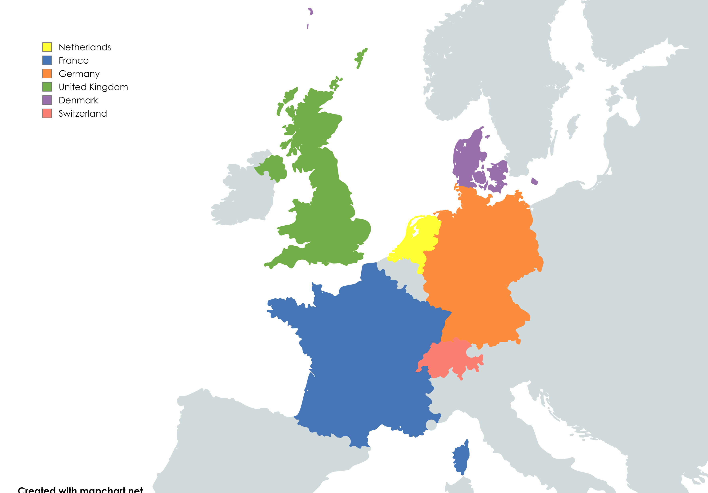
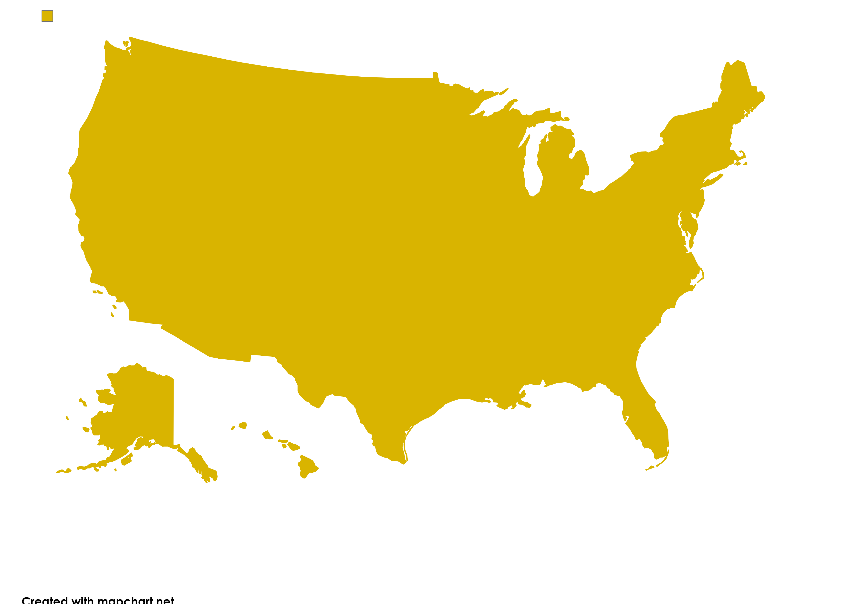
Overview of Life Science Companies
Life Science and biotech companies by Country and sector
USA
Netherlands
France
Germany
United Kingdom
Denmark
Switzerland
Biotech 1609
Biotech 537
Life Science 400
Life Science 2385
Biotech
250
Life Science 836
Life Science
14746
Life Science
2314
Biotech
9085
Biotech 1330
Life Science 1577
Life Science 1426
Biotech 967
Biotech
795
For the definition of categories please visit www.biotechgate.com/web/cms/index.php/covered_industry_sectors.html. For comparison, the graph shows the rate of companies by sector per million residents of each country. Life Science companies include Biotechnology, Pharma (Fully Integrated), Medical Technology and Digital Health. Biotechnology companies are a subset of life science companies and include the following categories: Biotechnology – Therapeutics and Diagnostics; Biotechnology – R&D; Biotechnology – Other. Information displayed may alter as new information is received continuously.

Slide 19
Overview of Life Science Companies
Life Science companies by Country and sector
For the definition of categories please visit www.biotechgate.com/web/cms/index.php/covered_industry_sectors.html. For comparison, the graph shows the rate of companies by sector per million residents of each country. Biotechnology companies include the following categories: Biotechnology – Therapeutics and Diagnostics; Biotechnology – R&D; Biotechnology – Other. Information displayed may alter as new information is received continuously.
19

Slide 20
Overview of Biotech companies
BIOTECH companies by Country and sector
For the definition of categories please visit www.biotechgate.com/web/cms/index.php/covered_industry_sectors.html. Biotech - Other includes AgBio, cosmetics, environmental, food, industrial biotechnology, nutraceuticals, and veterinary companies. For comparison, the graph shows the rate of biotech companies by subsector per million residents of each country. Information displayed may alter as new information is received continuously.

Slide 21
BIOTECH ASSETS IN CLINICAL DEVELOPMENT
Breakdown by top three indications of Netherlands
The graph contains the rate of assets of Biotech – Therapeutics and Diagnostics companies per million residents of each country (excl. of Pharma or Biotech – Others or Biotech – R&D Services companies). The top three indications of the Netherlands shown are Oncology, Neurology and Infectiology/parasitology.

Slide 22
Therapeutics By development phase
preclinical and phase i
The graph contains the rate of assets of Biotech – Therapeutics and Diagnostics companies per million residents of each country (excl. of Pharma or Biotech – Others or Biotech R&D Services companies). Products in Discovery and Lead Optimization Phase are merged into Preclinical. Information displayed in the chart may alter as new information is received continuously.

Slide 23
COMPANY Foundation timeline
Rate OF LIFE SCIENCE COMPANIES FOUNDED BY YEAR Per million residents | 2015-2024
The graph contains the rate of privately owned or publicly listed (no subsidiaries) life science companies founded by year per million residents of each country, including Biotech - Therapeutic and Diagnostic, Biotech - R&D Services, Biotech – Others, Pharma, Medical Technology and Digital Health companies. Companies founded in 2025 were excluded since newly founded companies often remain under the radar until their first financing round. Information displayed in the chart may alter as new information is received continuously.

Slide 24
Venture financing OF LIFE SCIENCE companies
Private Equity Rounds of Life Science companies (Europe and usa) | 2024-2025
LIFE SCIENCE COMPANIES
Biotech companies
Life Science companies include Biotech - Therapeutics and Diagnostics, Biotech - R&D Services, Biotech – Others, Pharma, Medical Technology and Digital Health companies. Financing data only includes private equity rounds (excl. private placements in public companies). Data may alter as new information is continuously received and/or new tranches to existing financing rounds are added.

Slide 25
Venture financing OF LIFE SCIENCE companies
Private Equity Rounds of Life Science companies | 2024-2025
Life Science companies include Biotech - Therapeutics and Diagnostics, Biotech - R&D Services, Biotech – Others, Pharma, Medical Technology and Digital Health companies. Financing data only includes private equity rounds (excl. private placements in public companies). Data may alter as new information is continuously received and/or new tranches to existing financing rounds are added. The graph shows the benchmark countries excl. the United States.

Slide 26
Venture financing OF Biotech companies
Private Equity Rounds of Biotech companies | 2024-2025
Biotech companies are a subset of Life Science companies and include: Biotech - Therapeutics and Diagnostics, Biotech - R&D Services, Biotech – Others. Financing data only includes private equity rounds (excl. private placements in public companies). Data may alter as new information is continuously received and/or new tranches to existing financing rounds are added. The graph shows the benchmark countries excl. the United States.

Slide 27
Major biotech venture financing rounds (2025)
TOP PRIVATE EQUITY FINANCING ROUNDS | 2025
Company | Type of Round | USD M | Country
Verdiva Bio Limited | Series A | $410.00 | United Kingdom
Tubulis GmbH | Series C | $403.34 | Germany
Windward Bio AG | Series A | $200.00 | Switzerland
Hemab Aps | Series C | $157.00 | Denmark
Artios Pharma Limited | Series D | $151.06 | United Kingdom
Azafaros B.V. | Series B | $149.36 | Netherlands
Draig Therapeutics Ltd | Series A | $140.00 | United Kingdom
GlycoEra AG | Series B | $130.00 | Switzerland
Adcytherix BV | Series A | $123.11 | France
CellCentric Ltd. | Series C | $120.00 | United Kingdom
The table shows the biggest private equity financing rounds (excl. IPOs, research grants, loans) of private and independent biotechnology – therapeutics and diagnostics companies in the EU and UK in 2025. Information displayed in the table may alter as new information is continuously received and/or new tranches to existing financing rounds are added. The table only shows the benchmark countries excl. the United States.

Slide 28

About Biotechgate
Biotechgate is a leading business development and licensing database for the entire life science industry, offering a wealth of information on over 65,000 life science company profiles. Thanks to its unique data sourcing process, the profiles include company descriptions, contact information, product pipeline information, financing rounds, and management details, making it an invaluable resource for big pharma, start-ups, investors, and other industry professionals. Biotechgate also features 45,000 licensing deals and a clinical trials database containing over 1’000,000 records from registries around the world.
To request a free demo or to learn more about the different subscription options, please visit Biotechgate.

Slide 29
Terms of use
The Life Sciences Trend Analysis is based on data entered in the Biotechgate Database available at www.biotechgate.com. The statistics and graphs in this presentation are based on figures and information entered in this database and we do not guarantee any accuracy hereof.
The use of the figures and graphs provided in this report is free of charge for any presentations as long as www.biotechgate.com is clearly cited as the source. For all other uses please contact us for terms and conditions.
Biotechgate
c/o Venture Valuation VV AG
Kasernenstrasse 11
8004 Zurich
Switzerland
+41 (43) 321 86 60
www.venturevaluation.com

